Slide 1

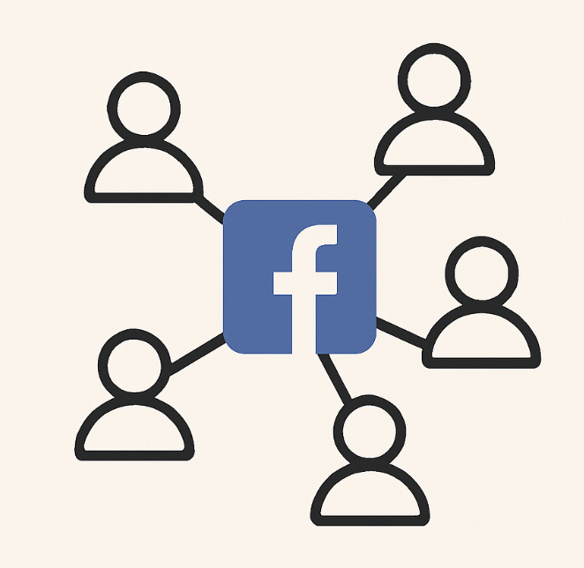
ClusterQuest - Unlocking Social Network Insights with Graph Clustering
UNDERSTANDING COMMUNITIES IN FACEBOOK-LIKE PLATFORMS
TEAM MEMBERS
CARLOS A. ORTIZ MONTES DE OCA
SWATHI SUBRAMANYAM PABBATHI
ALEJANDRO MARCHINI
AAI-510
SUMMER 2025 USD

Slide 2

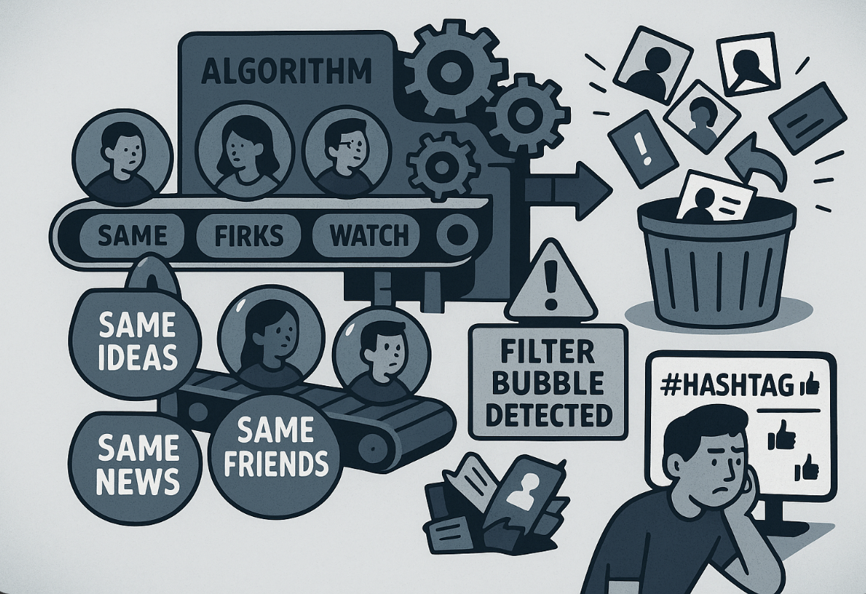
What’s Broken in Recommendations today?
Hard to understand user behavior just from clicks and likes
1
One-size-fits-all recommendations often miss the mark
2
3
Limited personalization and targeting
4
Communities in social networks often invisible
SUMMER 2025 USD
3

Slide 3
Mapping the Hidden Social Graph
EDA - Feature Engineering
Model Building
Evaluation and Deployment
Treat users and connections as a graph.
Derive features.
Use clustering to find natural communities.
Evaluate and visualize them.
Recommend based on user behaviour.
Our dataset has 4039 nodes and connections between them.
The graph is a fully connected undirected graph.
SUMMER 2025 USD
7

Slide 4
Mapping the Hidden Social Graph
EDA - Feature Engineering
Model Building
The dataset is sourced from the Stanford Network Analysis Project (SNAP) and consists of the Facebook Ego Network. It includes 4039 nodes (users), 88,234 undirected edges, representing mutual friendships and no additional node attributes (unweighted, undirected graph).
We derived the common graph features for Network Analysis, centrality Variation features, 2-Hop and Local Neighborhood Features, and additional community features (Louvain method).
Some of the features we calculated are:
Node, Degree, ClusteringCoefficient, BetweennessCentrality, ClosenessCentrality, PageRank, EigenvectorCentrality, Eccentricity, LocalClusterDensities, sorensen_indices, CommunitySize, CommunityDensity, CommunityAssortativity
Use clustering to find natural communities.
Evaluation and Deployment
Evaluate and visualize them.
Recommend based on user behaviour.
SUMMER 2025 USD
3

Slide 5
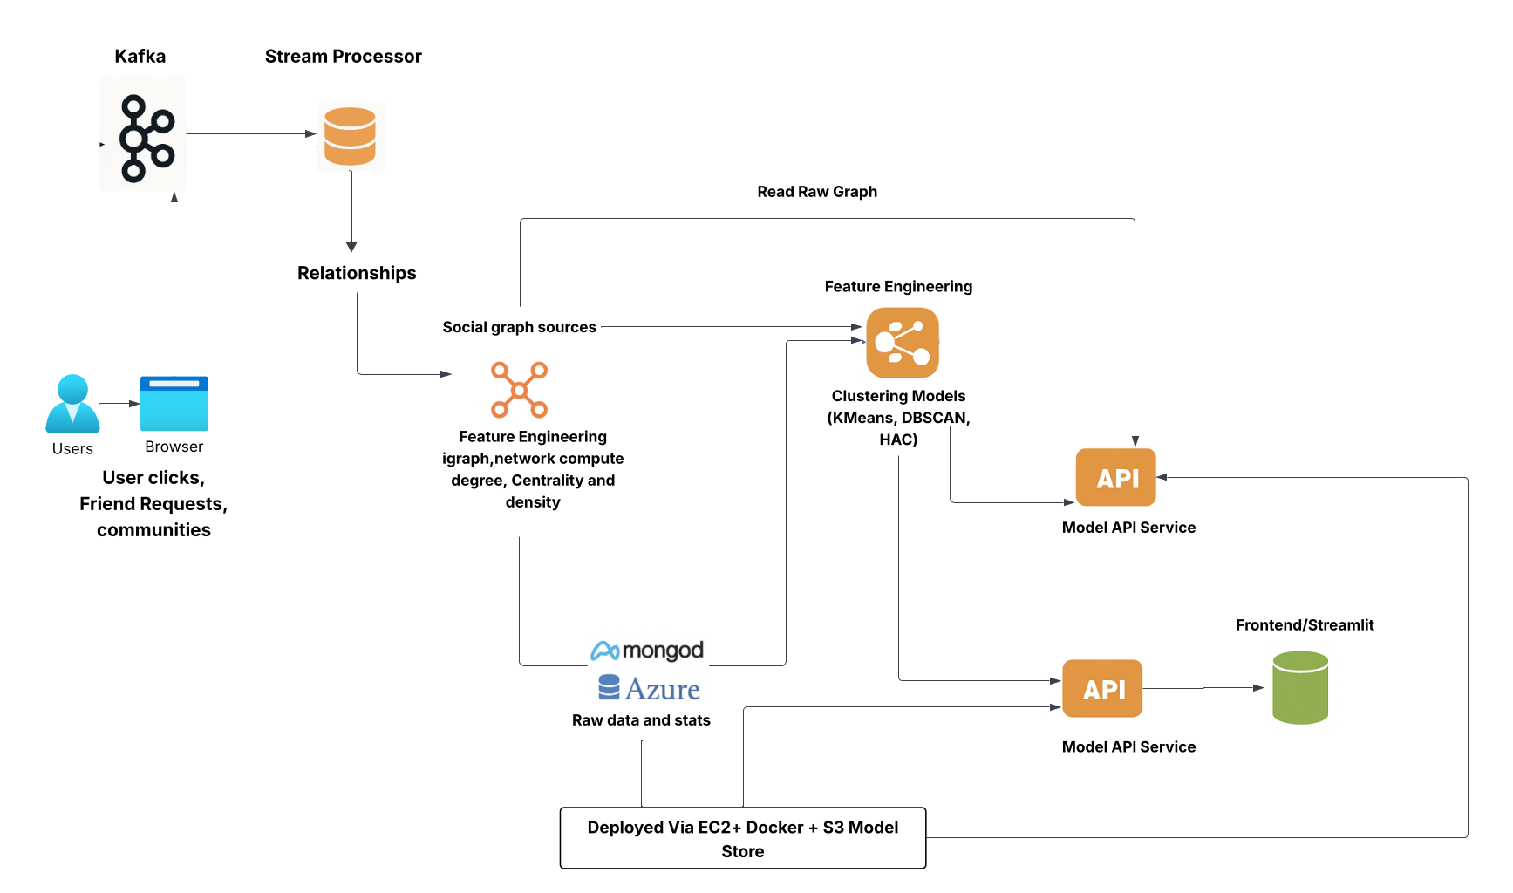
Full Architecture Diagram:
SUMMER 2025 USD
5

Slide 6
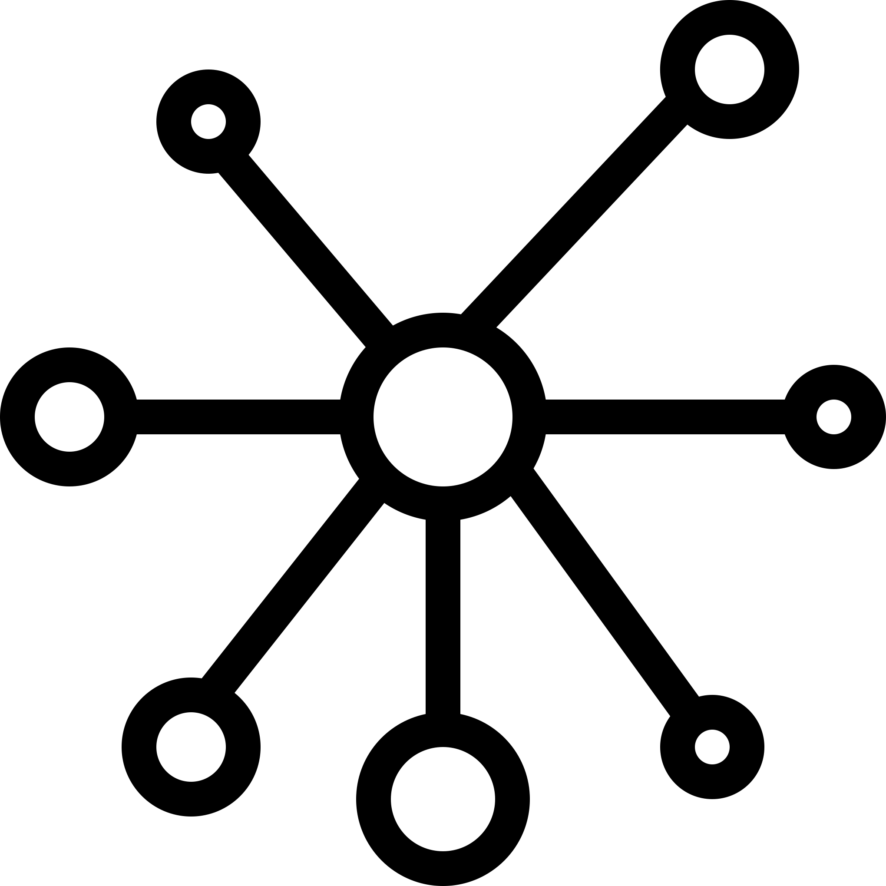
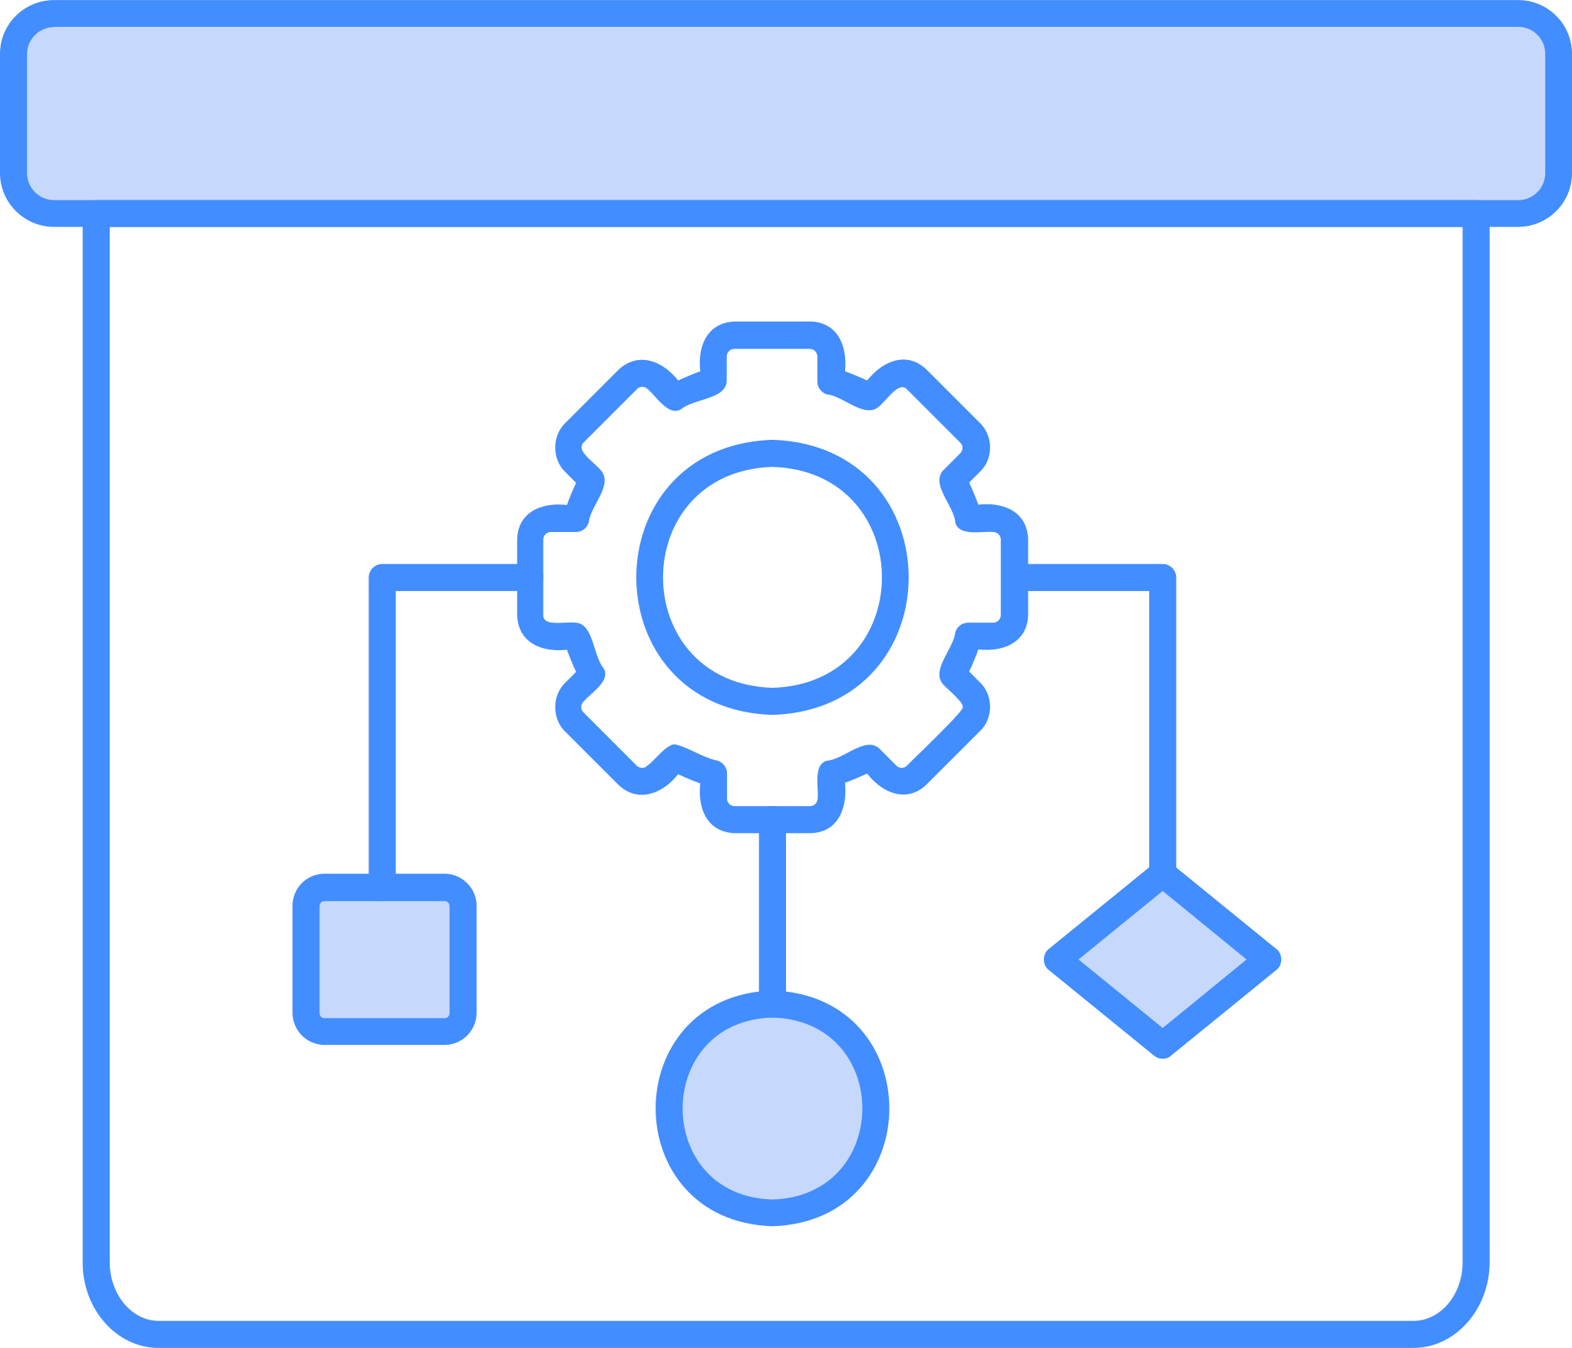
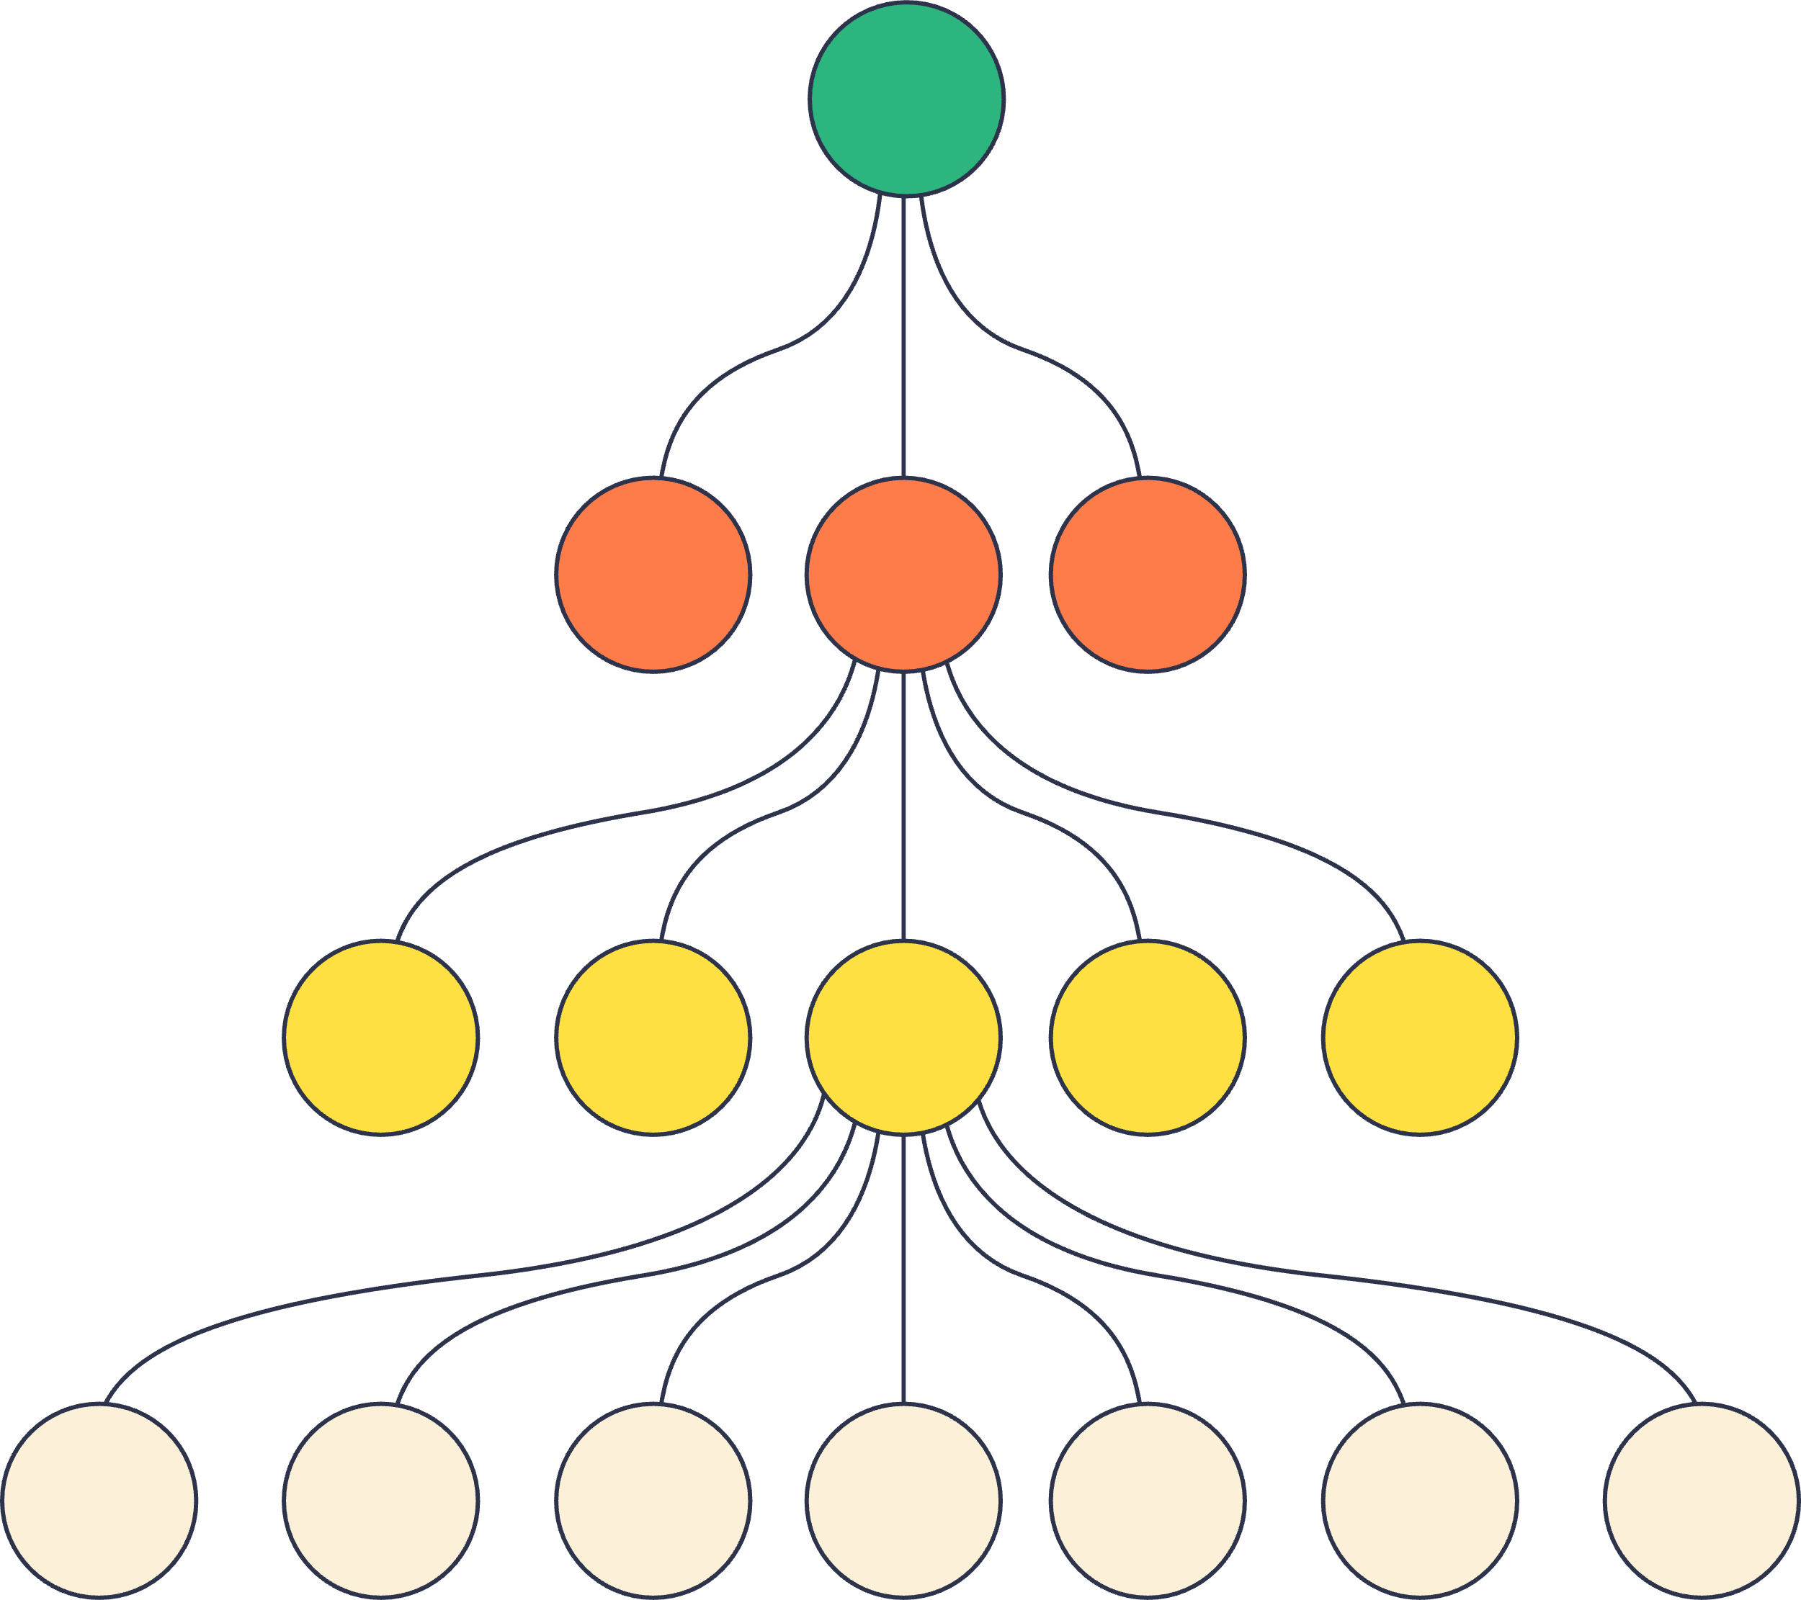
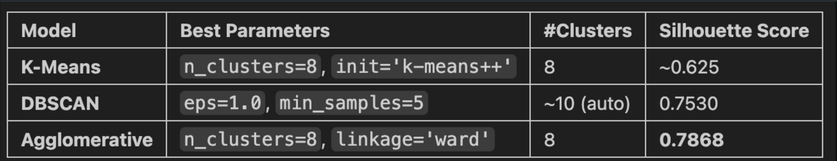
Techniques Used - Three Clustering models compared
Hierarchical Clustering
K-Means
DBSCAN
SUMMER 2025 USD
4

Slide 7
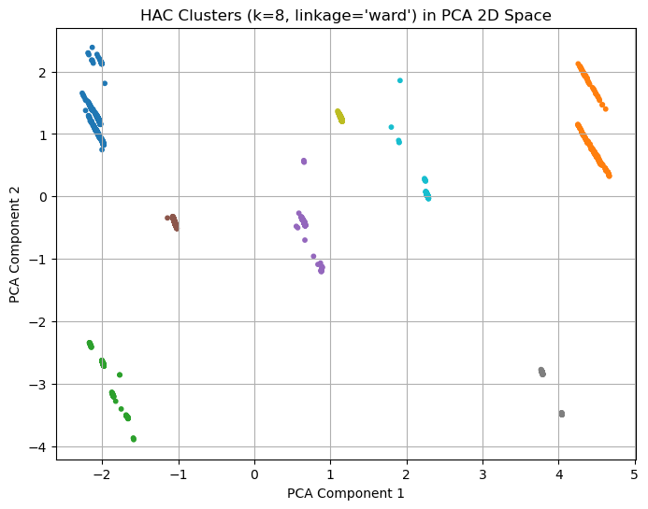
Best Fit Model In Performance Visualization
SUMMER 2025 USD
5

Slide 8
Clusters - Key Insights
8 natural clusters emerged,
Some users are highly connected influencers,
Others are isolated or niche members,
Each cluster has unique characteristics some form close-knit communities,
Others are highly connected influencers and
A few are on the fringe.

Slide 9
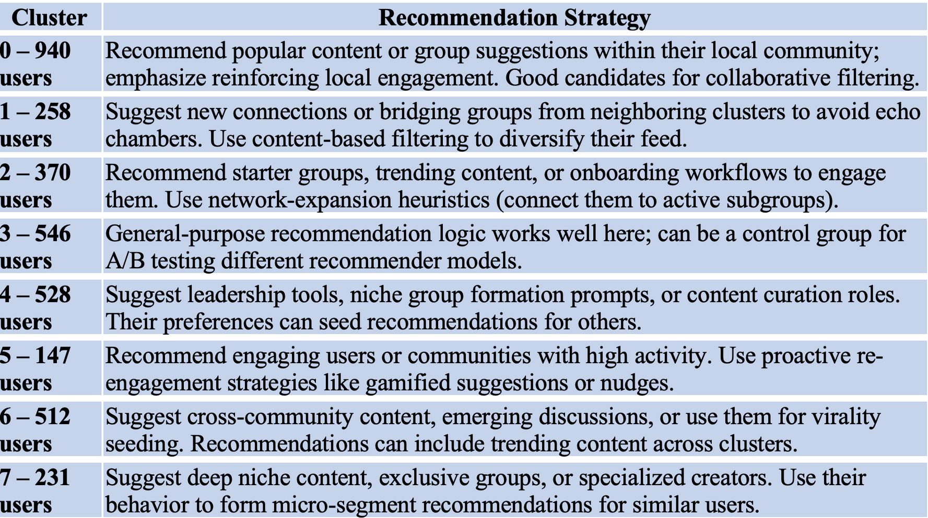
What We Learned from Clusters
6
SUMMER 2025 USD

Slide 10
Business Impact - Why This Is Valuable
Boosts engagement
Improves retention
Solves cold start
Delivers relevant suggestions using only the structure of the social graph
No behavioral or personal data required, supporting privacy-first platforms and regulatory compliance
Recommends users, groups, or content with structural similarity or proximity in the network
Leads to stronger, more lasting interactions that increase time-on-platform
Makes high-quality recommendations for new users even in the absence of usage history
Surfaces niche content and communities
Efficient and scalable
Identifies emerging or under-connected clusters, promoting content diversity and long-tail engagement that traditional algorithms might overlook
Graph algorithms require less compute than deep models, are easier to maintain and audit
Supports real-time or near-real-time recommendations with explainable logic
SUMMER 2025 USD
7

Slide 11
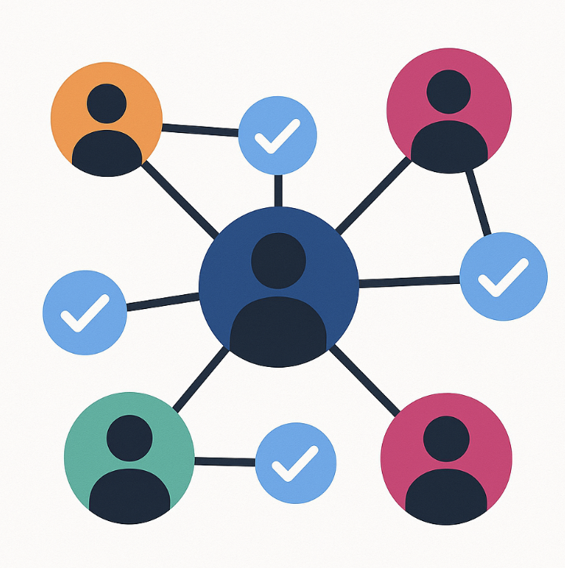
Summary - Why This Matters
Graph-based clustering reveals real user communities.
1
Enables context-aware, group-sensitive recommendations.
2
Leads to higher engagement, retention, and personalization
3
SUMMER 2025 USD
3

Slide 12
Future Improvements & Trade-offs
Current Approach
Used node-edge dataset to extract network features.
Applied clustering algorithms for community detection.
Future Enhancements
Explore Graph Neural Networks (GNNs) or GAE for richer embeddings.
Consider deep learning for better accuracy and dynamic pattern detection.
Trade-offs
Clustering models: Low-cost, easy to implement, suitable for simple business use cases.
Neural networks: High accuracy & flexibility, but require more data, fine-tuning, and compute cost.
Limited dataset (no user metadata like clicks, likes, posts) affects NN potential.

Slide 13
References
McAuley, J., & Leskovec, J. (2012). Learning to discover social circles in ego networks. Stanford Network Analysis Project (SNAP). https://snap.stanford.edu/data/ego-Facebook.html
https://bookdown.org/omarlizardo/_main/6-origins.html#origins
Lizenberger, A., Pfeifer, F., & Polewka, B. (2024, May 28). Rethinking recommender systems: Cluster‑based algorithm selection (arXiv:2405.18011). arXiv. https://doi.org/10.48550/arXiv.2405.18011
Wang, H., Dai, Y., & Wang, W. (2025). Meta‑learning with graph community detection for cold‑start user clustering. Applied Sciences, 15(8), 4503. https://doi.org/10.3390/app15084503
Wu, X., Loveland, D., Chen, R., Liu, Y., Chen, X., Neves, L., Jadbabaie, A., Ju, M., Shah, N., & Zhao, T. (2025, January 29). GraphHash: Graph clustering enables parameter efficiency in recommender systems. In Proceedings of the ACM Web Conference (WWW ’25). https://openreview.net/pdf?id=U3TzIAg5Dg
Ying, R., He, R., Chen, K., Eksombatchai, P., Hamilton, W. L., & Leskovec, J. (2018, June 6). Graph Convolutional Neural Networks for web‑scale recommender systems (arXiv:1806.01973). arXiv. https://doi.org/10.48550/arXiv.1806.01973

Slide 14
The End
THANK YOU FOR LISTENING
AAI-510
SUMMER 2025 USD

